Slide 1
Project 2 – AIS
By Jan Pinto Strohhäusl, Group 2
Notes:
hello and welcome to this presentation
name is jan pinto strohhäusl, im from group 2
- This presentation is to sum up work of our group on project 2

Slide 2
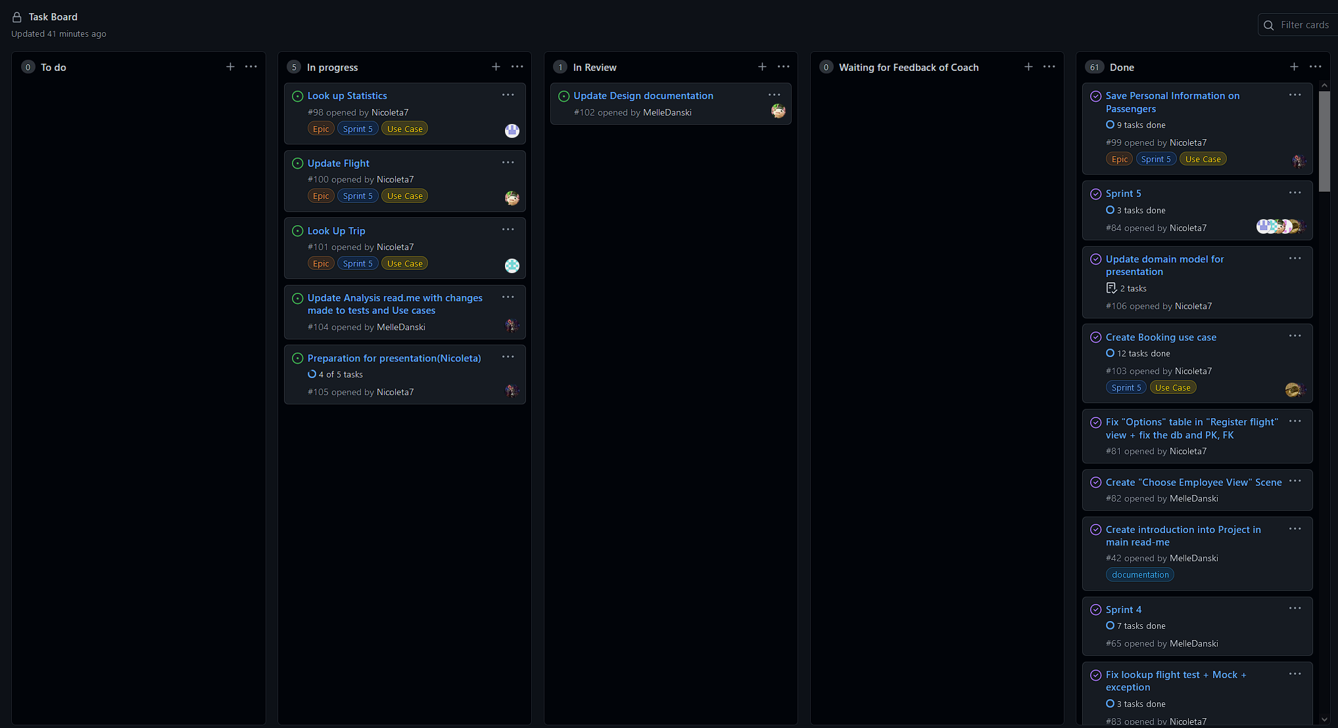
Project Management
Agile approach with scrum
2 – 3 week Sprints
Meeting with tutor
Notes:
- agile approach with scrum
- sprint for 2-3 weeks
- meeting every week to discuss what is done and what is still left
- weekly meeting with tutor to check if errors we did not notice
- created task board to divide tasks

Slide 3
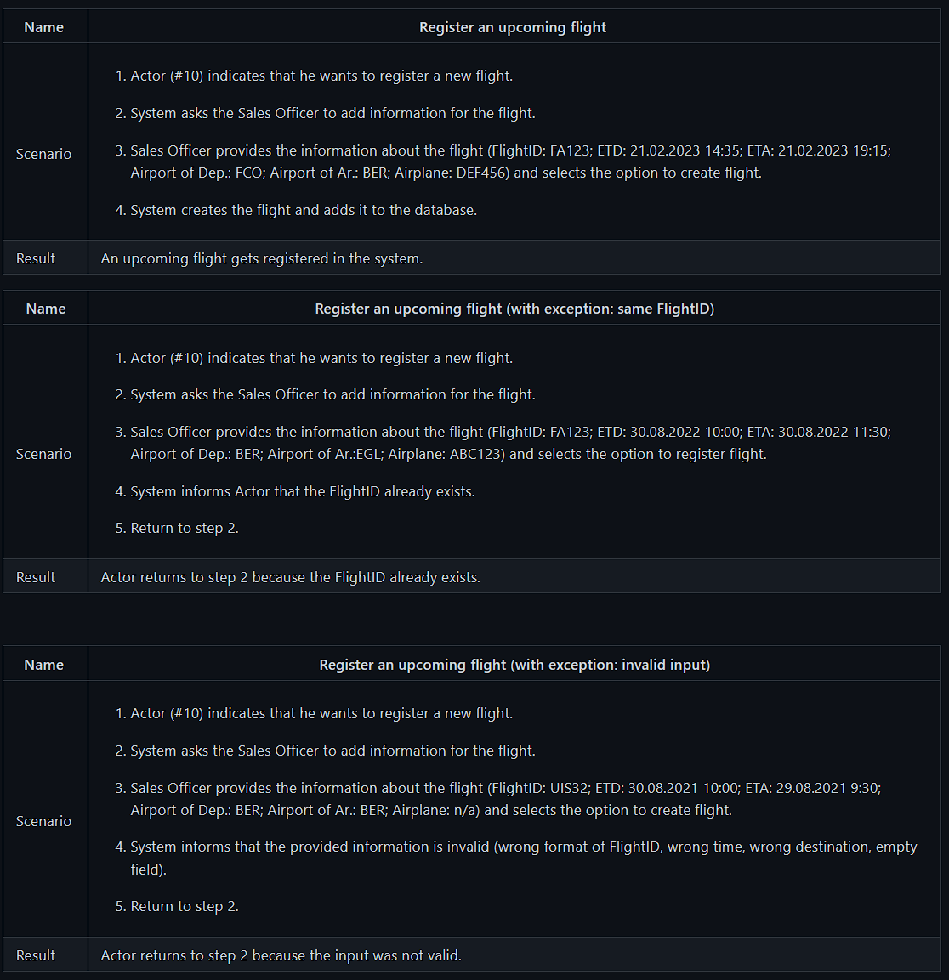
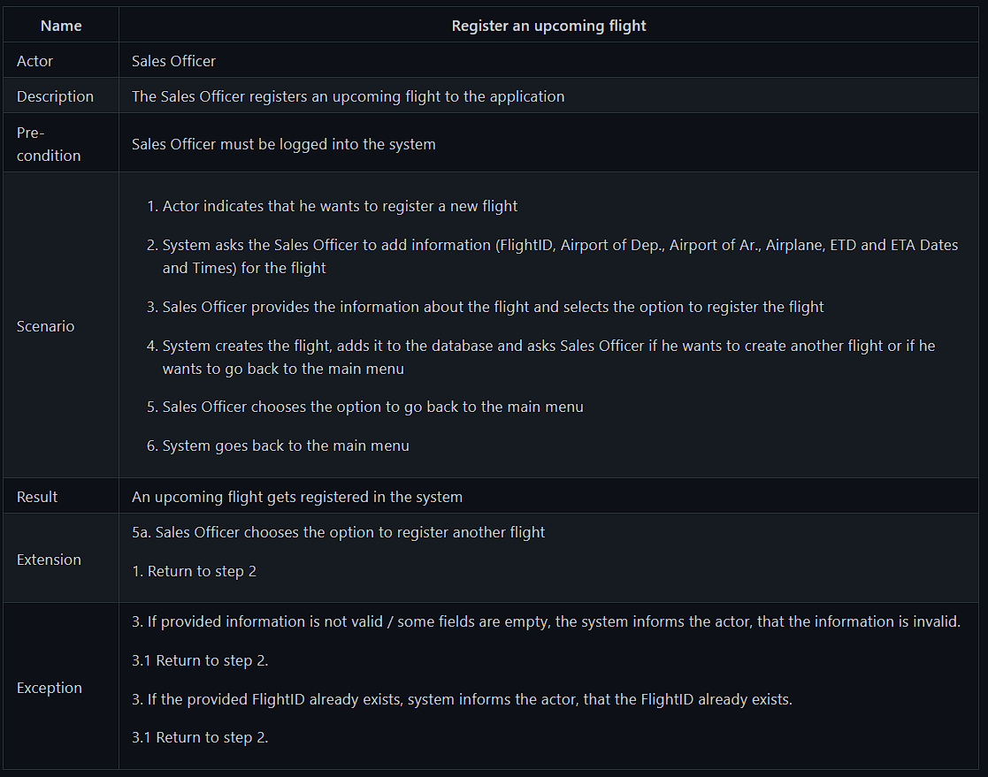
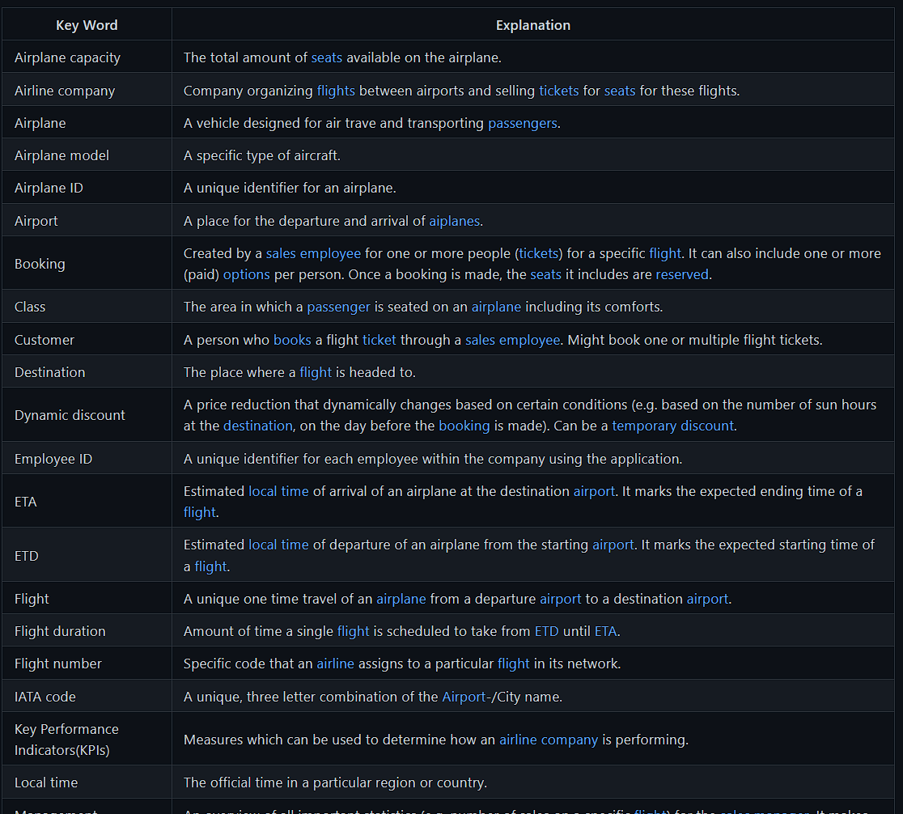
Analysis
Notes:
- focus on register a new flight
for every use case a use case description with extensions and exceptions
test scenario
- created data dictionary to have better understanding for each object

Slide 4
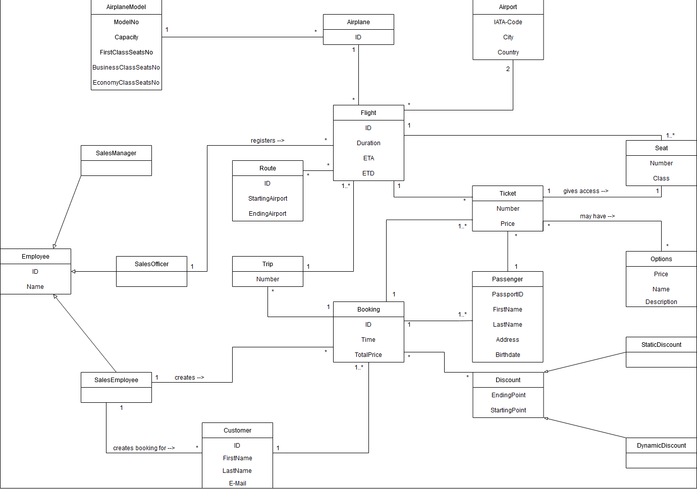
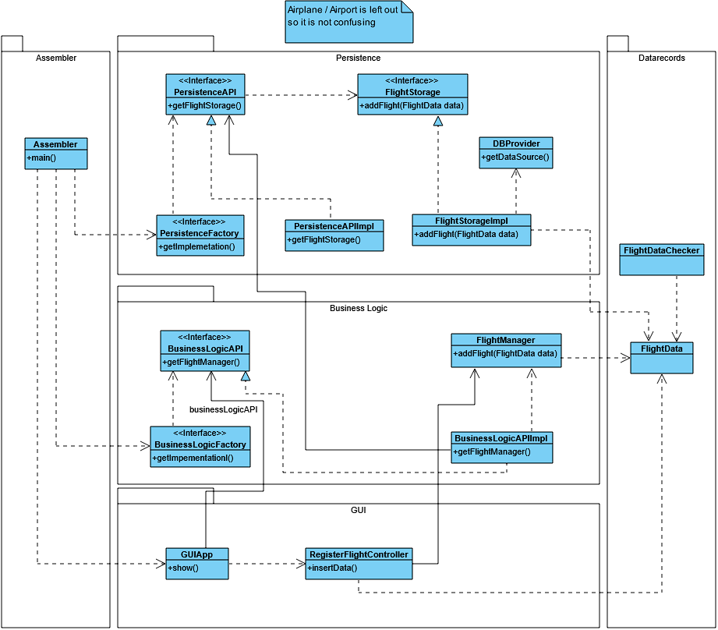
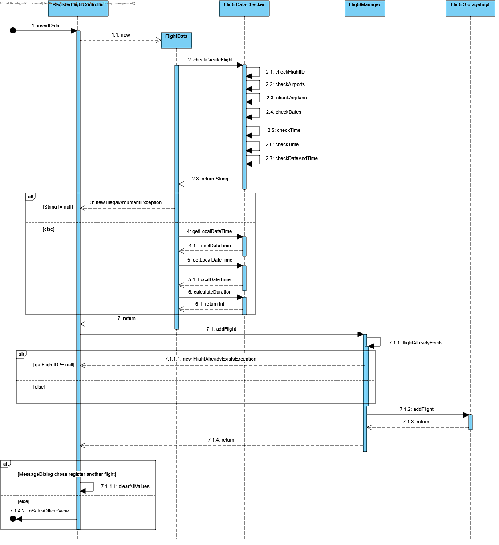
Design
Notes:
created domain model based on data dictionary to understand the relations between the objects better
created class diagram for use cases to set relations more in a context of a specific use case
created sequence diagram to better understand a complex method

Slide 5
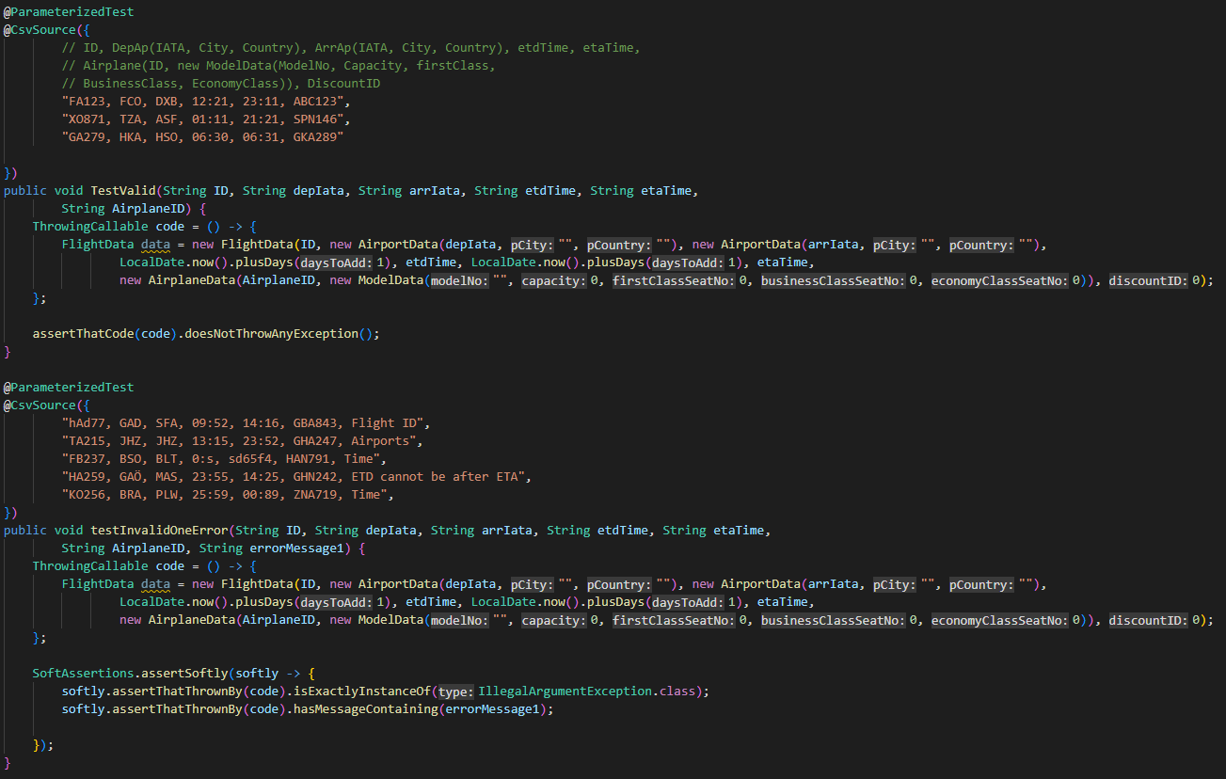
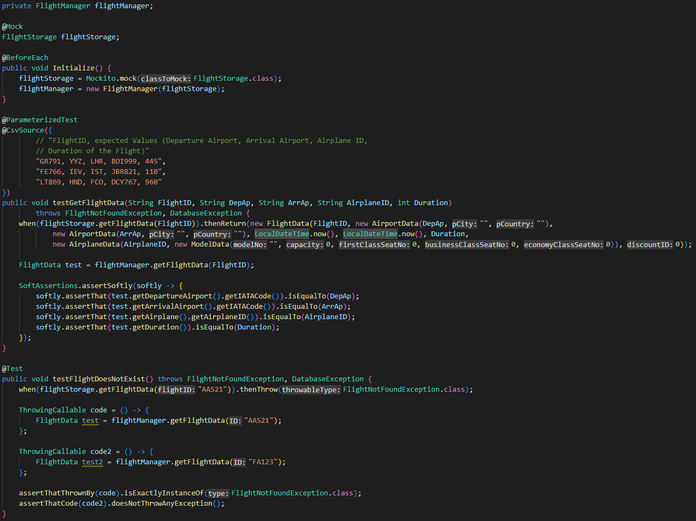
Implementation – Tests
Notes:
created tests based on test scenarios
- help us keep the implementation in line with analysis/design
testing flightdata valid and invalid data
testing manager passing data
mocking db to test independent from db

Slide 6
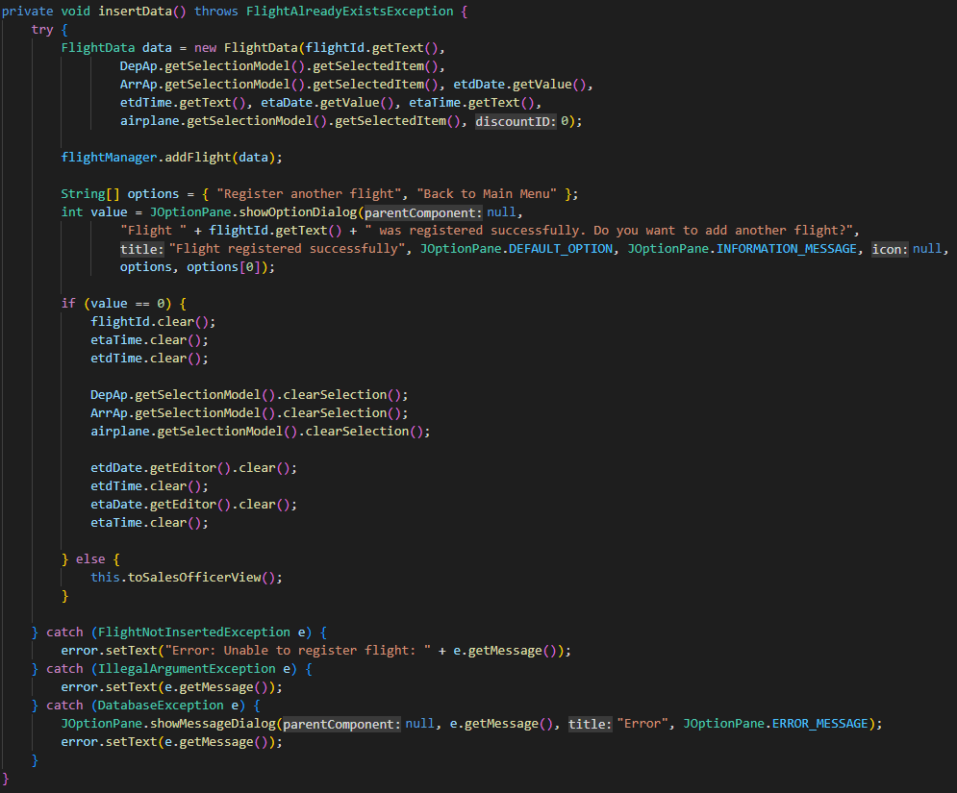
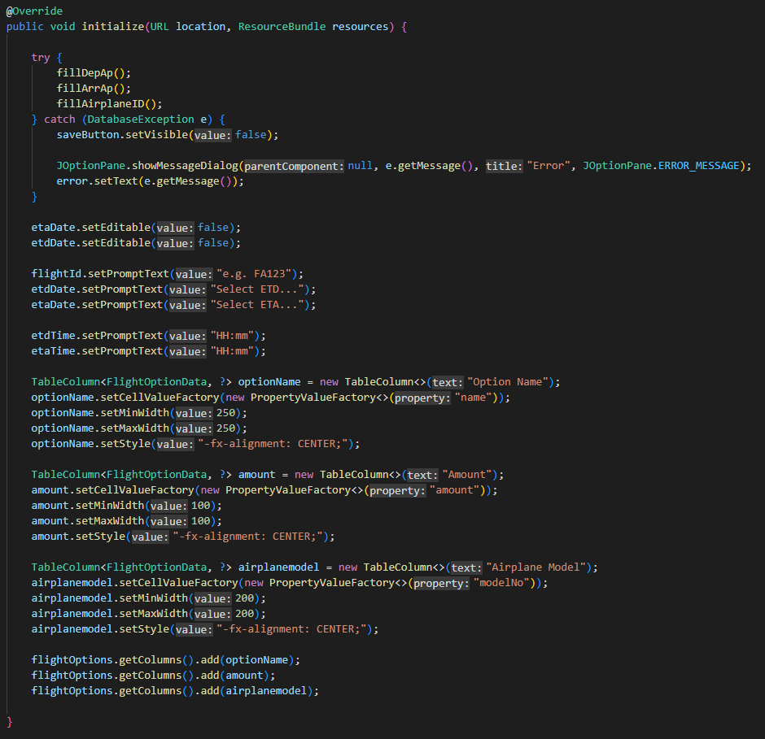
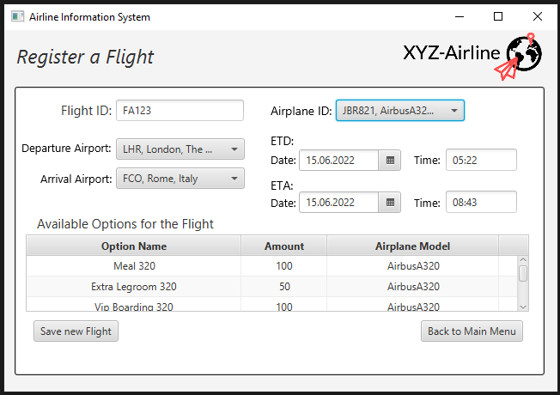
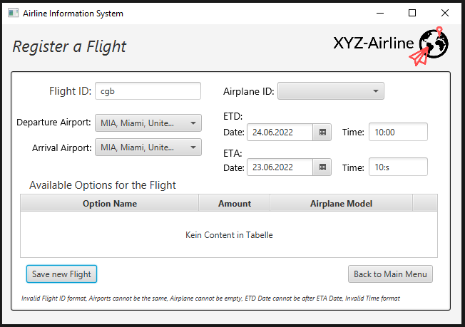
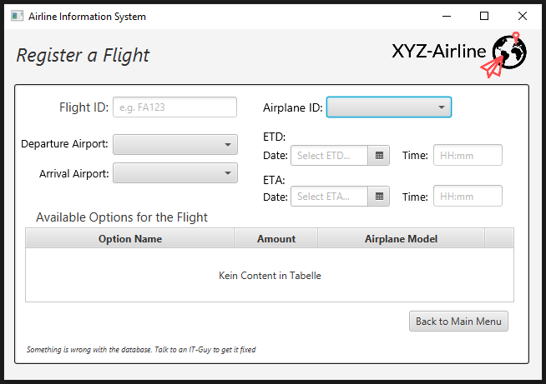
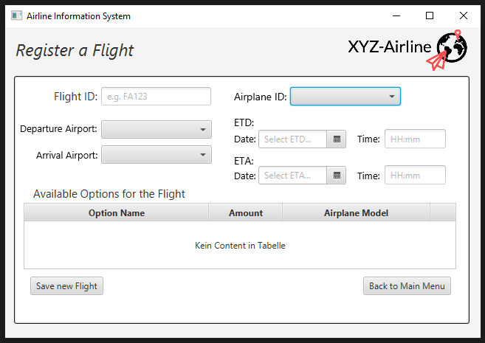
Implementation – code
Notes:
- now to implemented code
initial view
Initalize method, filling drop down menus for dep ap, arr ap and airplane
When problem (docker), databaseexception → save button invisible
Save button → insertdata method
First 2 lines most important
Throwing illegalargumentexception with error message when values invalid

Slide 7
Thank you for your attention!
Any Questions?
Notes:
This was it
Thank you for your attention
Looking forward to answer your questions

